Slide 1
Chapter 3b: Access Control Lists
Notes:
Cisco Networking Academy Program
Routing and Switching Essentials v6.0
Chapter 7: Access Control Lists

Slide 2
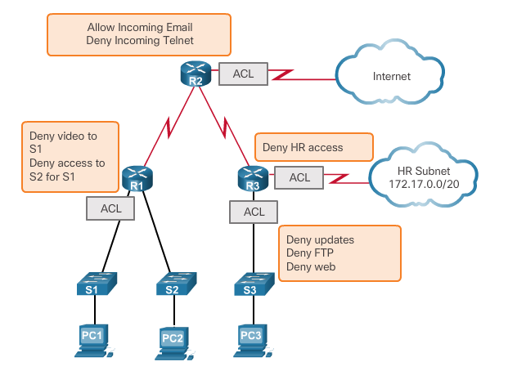
Purpose of ACLs
What is an ACL?
By default, a router does not have ACLs configured; therefore, by default a router does not filter traffic.
Notes:
7.1 – ACL Operation
7.1.1 – Purpose of ACLs
7.1.1.1 – What is an ACL?

Slide 3
Purpose of ACLs
Packet Filtering
Packet filtering, sometimes called static packet filtering, controls access to a network by analyzing the incoming and outgoing packets and passing or dropping them based on given criteria, such as the source IP address, destination IP addresses, and the protocol carried within the packet.
A router acts as a packet filter when it forwards or denies packets according to filtering rules.
An ACL is a sequential list of permit or deny statements, known as access control entries (ACEs).
Notes:
7.1 – ACL Operation
7.1.1 – Purpose of ACLs
7.1.1.2 – Packet Filtering

Slide 4
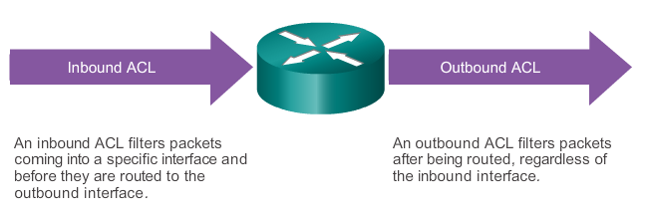
Purpose of ACLs
ACL Operation
Notes:
7.1 – ACL Operation
7.1.1 – Purpose of ACLs
7.1.1.3 – ACL Operation

Slide 5
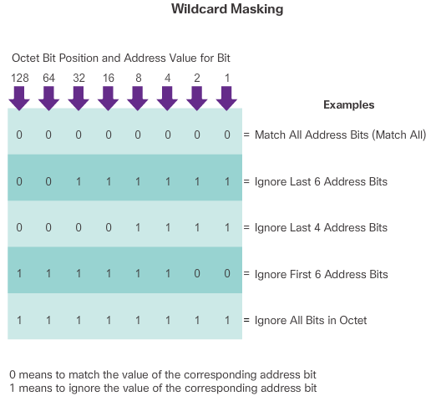
Wildcard Masks in ACLs
Introducing ACL Wildcard Masking
Notes:
7.1 – ACL Operation
7.1.2 – Wildcard Masks in ACLs
7.1.2.1 – Introducing ACL Wildcard Masking

Slide 6
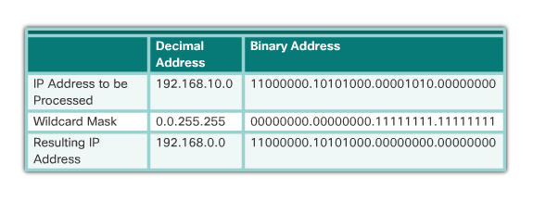
Wildcard Masks in ACLs
Introducing ACL Wildcard Masking (cont.)
Example
Notes:
7.1 – ACL Operation
7.1.2 – Wildcard Masks in ACLs
7.1.2.1 – Introducing ACL Wildcard Masking (cont.)

Slide 7
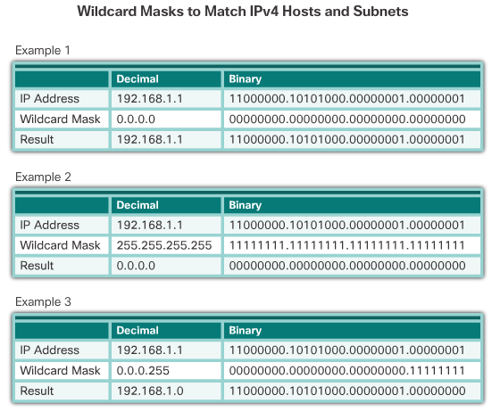
Wildcard Masks in ACLs
Wildcard Mask Examples
Notes:
7.1 – ACL Operation
7.1.2 – Wildcard Masks in ACLs
7.1.2.2 - Wildcard Mask Examples

Slide 8
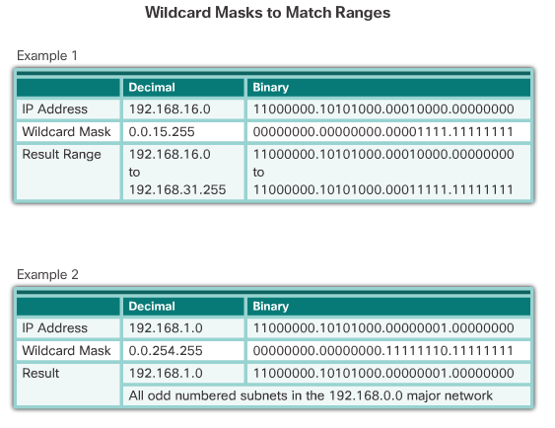
Wildcard Masks in ACLs
Wildcard Mask Examples (cont.)
Notes:
7.1 – ACL Operation
7.1.2 – Wildcard Masks in ACLs
7.1.2.2 - Wildcard Mask Examples

Slide 9
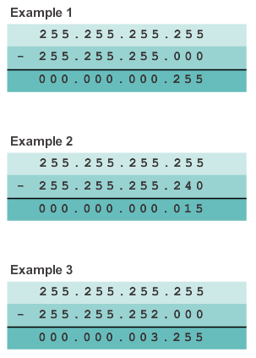
Wildcard Masks in ACLs
Calculating the Wildcard Mask
Calculating wildcard masks can be challenging. One shortcut method is to subtract the subnet mask from 255.255.255.255.
Notes:
7.1 – ACL Operation
7.1.2 – Wildcard Masks in ACLs
7.1.2.3 - Calculating the Wildcard Mask

Slide 10
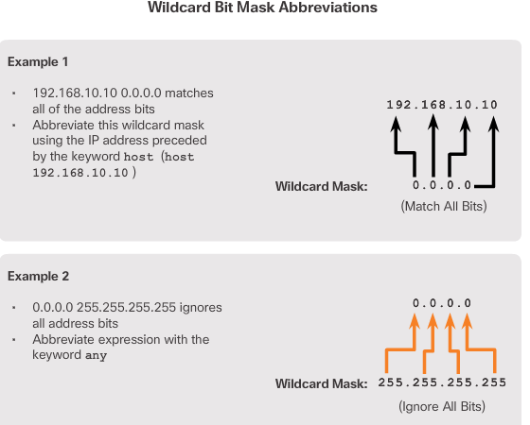
Wildcard Masks in ACLs
Wildcard Mask Keywords
Notes:
7.1 – ACL Operation
7.1.2 – Wildcard Masks in ACLs
7.1.2.4 - Wildcard Mask Keywords

Slide 11
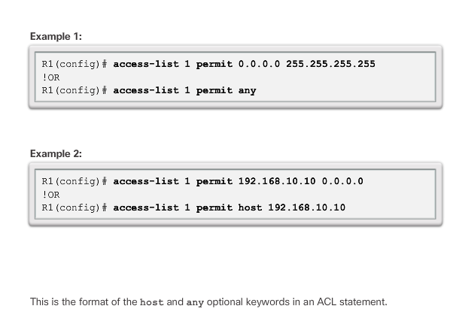
Wildcard Masks in ACLs
Wildcard Mask Keyword Examples
Notes:
7.1 – ACL Operation
7.1.2 – Wildcard Masks in ACLs
7.1.2.5 - Wildcard Mask Keyword Examples

Slide 12
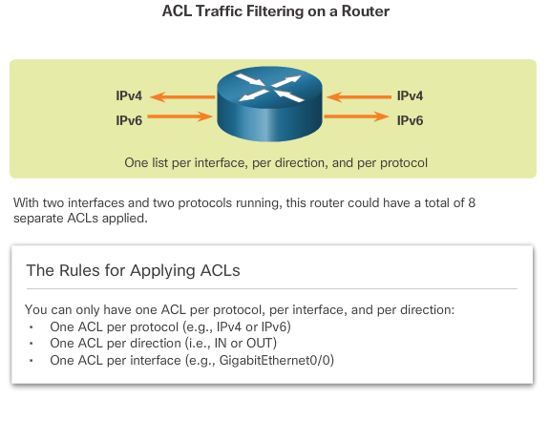
Guidelines for ACL Creation
General Guidelines for Creating ACLS
Notes:
7.1 – ACL Operation
7.1.3 – Guidelines for ACL Creation
7.1.3.1 - General Guidelines for Creating ACLS

Slide 13
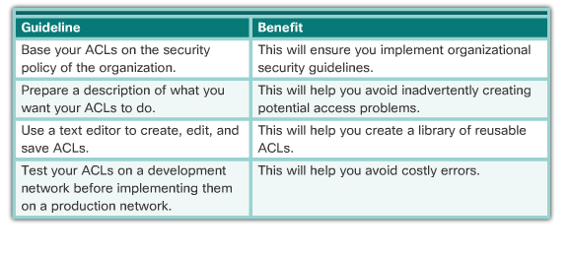
Guidelines for ACL Creation
ACL Best Practices
Notes:
7.1 – ACL Operation
7.1.3 – Guidelines for ACL Creation
7.1.3.2 - ACL Best Practices

Slide 14
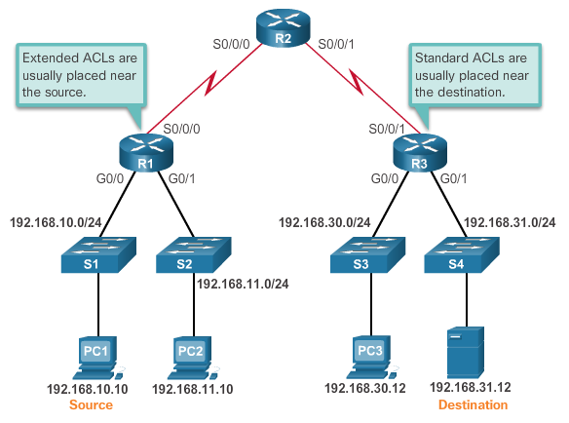
Guidelines for ACL Placement
Where to Place ACLs
Notes:
7.1 – ACL Operation
7.1.4 – Guidelines for ACL Placement
7.1.4.1 - Where to Place ACLs

Slide 15
Guidelines for ACL Placement
Where to Place ACLs (cont.)
Every ACL should be placed where it has the greatest impact on efficiency. The basic rules are:
  Extended ACLs - Locate extended ACLs as close as possible to the source of the traffic to be filtered.
  Standard ACLs - Because standard ACLs do not specify destination addresses, place them as close to the destination as possible.
  Placement of the ACL, and therefore the type of ACL used, may also depend on: the extent of the network administrator’s control, bandwidth of the networks involved, and ease of configuration.
Notes:
7.1 – ACL Operation
7.1.4 – Guidelines for ACL Placement
7.1.4.1 - Where to Place ACLs

Slide 16
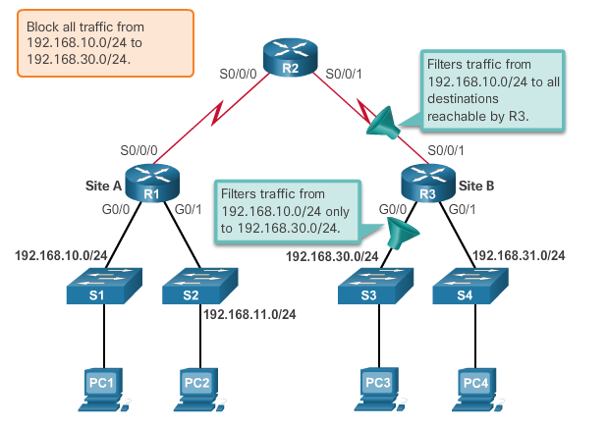
Guidelines for ACL Placement
Standard ACL Placement
The administrator wants to prevent traffic originating in the 192.168.10.0/24 network from reaching the 192.168.30.0/24 network.
Notes:
7.1 – ACL Operation
7.1.4 – Guidelines for ACL Placement
7.1.4.2 - Standard ACL Placement

Slide 17
7.2 Standard IPv4 ACLs
Notes:
Cisco Networking Academy Program
Routing and Switching Essentials v6.0
Chapter 7: VLANs

Slide 18
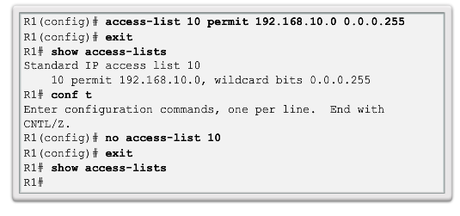
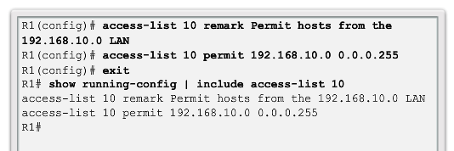
Configure Standard IPv4 ACLs
Numbered Standard IPv4 ACL Syntax
Router(config)# access-list access-list-number { deny | permit | remark } source [ source-wildcard ] [ log ]
Notes:
7.2 – Standard IPv4 ACLs
7.2.1 – Configure Standard IPv4 ACLs
7.2.1.1 - Numbered Standard IPv4 ACL Syntax

Slide 19
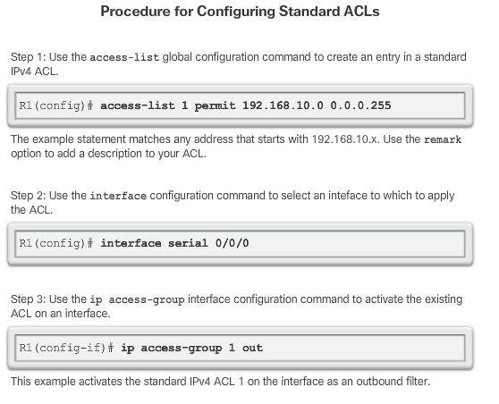
Configure Standard IPv4 ACLs
Applying Standard IPv4 ACLs to Interfaces
Notes:
7.2 – Standard IPv4 ACLs
7.2.1 – Configure Standard IPv4 ACLs
7.2.1.2 - Applying Standard IPv4 ACLs to Interfaces

Slide 20
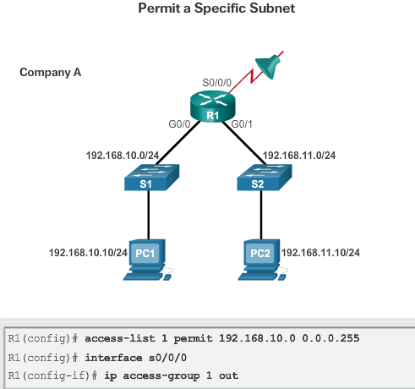
Configure Standard IPv4 ACLs
Applying Standard IPv4 ACLs to Interfaces (cont.)
Notes:
7.2 – Standard IPv4 ACLs
7.2.1 – Configure Standard IPv4 ACLs
7.2.1.2 - Applying Standard IPv4 ACLs to Interfaces

Slide 21
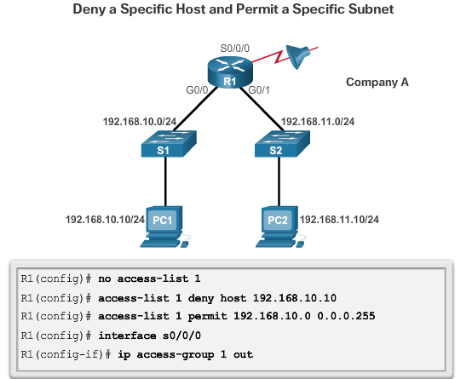
Configure Standard IPv4 ACLs
Numbered Standard IPv4 ACL Examples
Notes:
7.2 – Standard IPv4 ACLs
7.2.1 – Configure Standard IPv4 ACLs
7.2.1.3 - Numbered Standard IPv4 ACL Examples

Slide 22
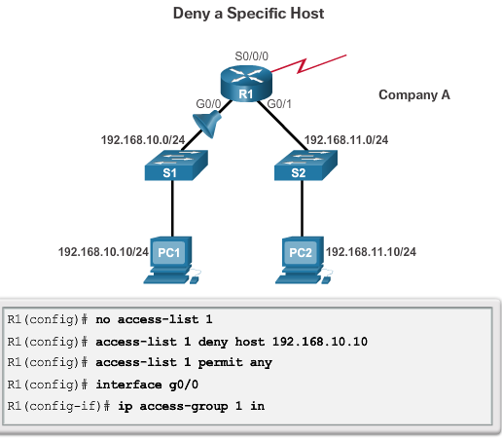
Configure Standard IPv4 ACLs
Numbered Standard IPv4 ACL Examples (cont.)
Notes:
7.2 – Standard IPv4 ACLs
7.2.1 – Configure Standard IPv4 ACLs
7.2.1.3 - Numbered Standard IPv4 ACL Examples

Slide 23
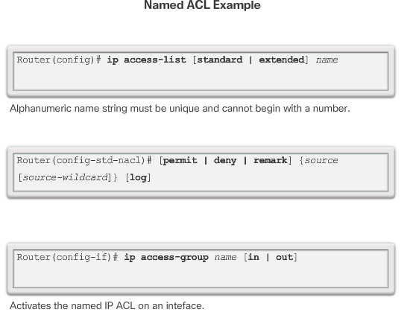
Configure Standard IPv4 ACLs
Named Standard IPv4 ACL Syntax
Notes:
7.2 – Standard IPv4 ACLs
7.2.1 – Configure Standard IPv4 ACLs
7.2.1.4 - Named Standard IPv4 ACL Syntax

Slide 24
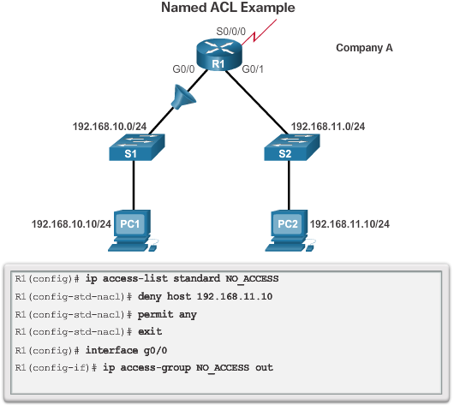
Configure Standard IPv4 ACLs
Named Standard IPv4 ACL Syntax (cont.)
Notes:
7.2 – Standard IPv4 ACLs
7.2.1 – Configure Standard IPv4 ACLs
7.2.1.4 - Named Standard IPv4 ACL Syntax

Slide 25
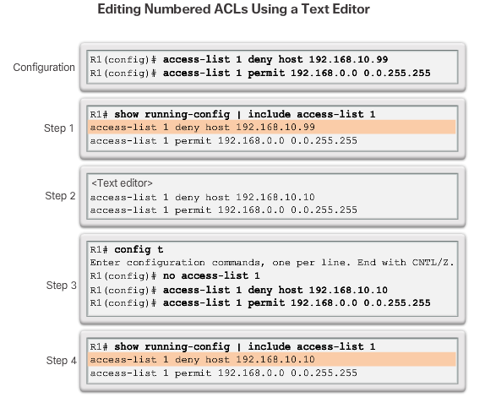
Modify IPv4 ACLs
Method 1 – Use a Text Editor
Notes:
7.2 – Standard IPv4 ACLs
7.2.2 – Modify IPv4 ACLs
7.2.2.1 - Method 1 – Use a Text Editor

Slide 26
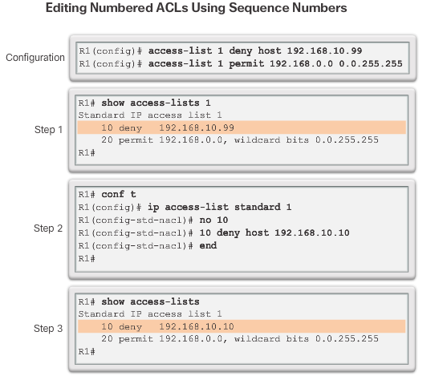
Modify IPv4 ACLs
Method 2 – Use Sequence Numbers
Notes:
7.2 – Standard IPv4 ACLs
7.2.2 – Modify IPv4 ACLs
7.2.2.2 - Method 2 – Use Sequence Numbers

Slide 27
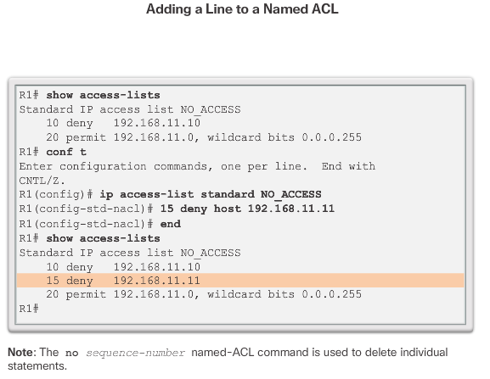
Modify IPv4 ACLs
Editing Standard Named ACLs
Notes:
7.2 – Standard IPv4 ACLs
7.2.2 – Modify IPv4 ACLs
7.2.2.3 - Editing Standard Named ACLs

Slide 28
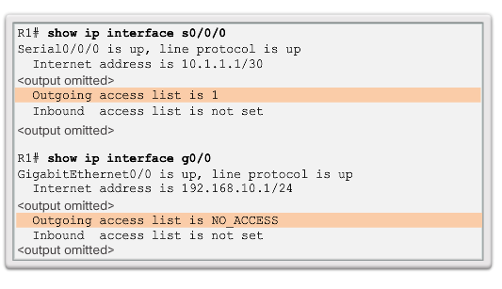
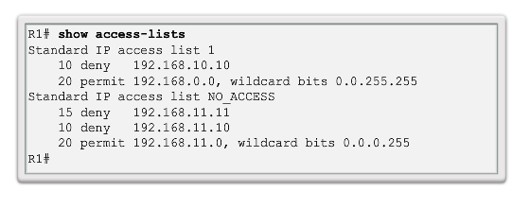
Modify IPv4 ACLs
Verifying ACLs
Notes:
7.2 – Standard IPv4 ACLs
7.2.2 – Modify IPv4 ACLs
7.2.2.4 - Verifying ACLs

Slide 29
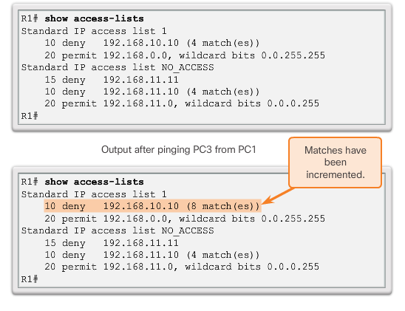
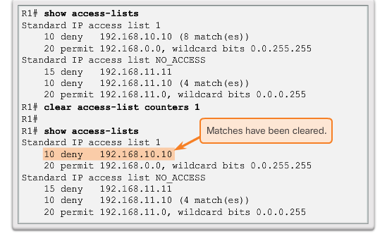
Modify IPv4 ACLs
ACL Statistics
Notes:
7.2 – Standard IPv4 ACLs
7.2.2 – Modify IPv4 ACLs
7.2.2.5 - ACL Statistics

Slide 30
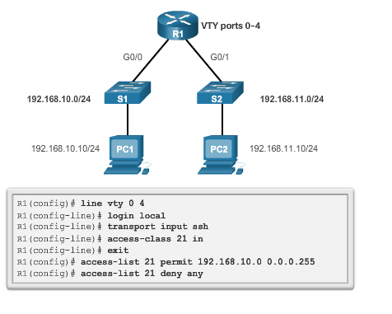
Securing VTY Ports with a Standard IPv4 ACL
The access-class Command
The access-class command configured in line configuration mode restricts incoming and outgoing connections between a particular VTY (into a Cisco device) and the addresses in an access list.
Notes:
7.2 – Standard IPv4 ACLs
7.2.3 – Securing VTY Ports with a Standard IPv4 ACL
7.2.3.1 - The access-class Command

Slide 31
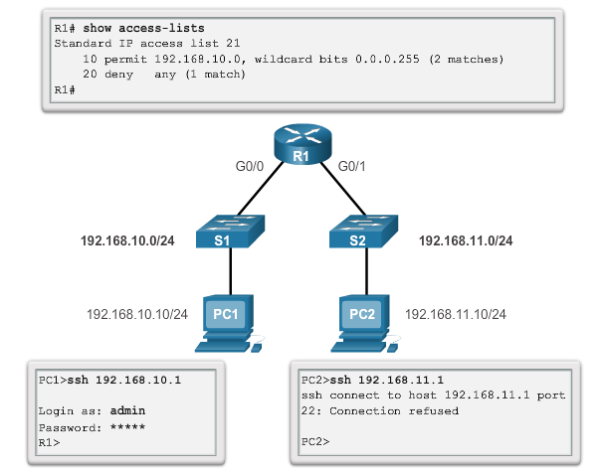
Securing VTY Ports with a Standard IPv4 ACL
Verifying the VTY Port is Secured
Notes:
7.2 – Standard IPv4 ACLs
7.2.3 – Securing VTY Ports with a Standard IPv4 ACL
7.2.3.2 - Verifying the VTY Port is Secured

Slide 32
7.3 Troubleshoot ACLs
Notes:
Cisco Networking Academy Program
Routing and Switching Essentials v6.0
Chapter 7: Access Control Lists

Slide 33
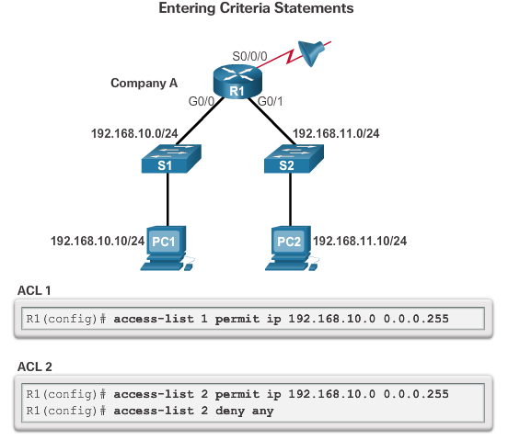
Processing Packet with ACLs
The Implicit Deny Any
At least one permit ACE must be configured in an ACL or all traffic is blocked.
For the network in the figure, applying either ACL 1 or ACL 2 to the S0/0/0 interface of R1 in the outbound direction will have the same effect.
Notes:
7.3 – Troubleshoot ACLs
7.3.1 – Processing Packets with ACLs
7.3.1.1 - The Implicit Deny Any

Slide 34
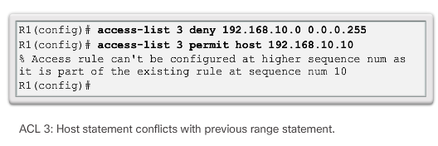
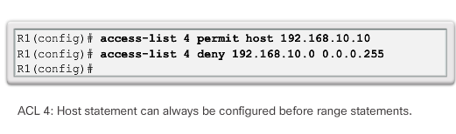
Processing Packet with ACLs
The Order of ACEs in an ACL
Notes:
7.3 – Troubleshoot ACLs
7.3.1 – Processing Packets with ACLs
7.3.1.2 - The Order of ACEs in an ACL

Slide 35
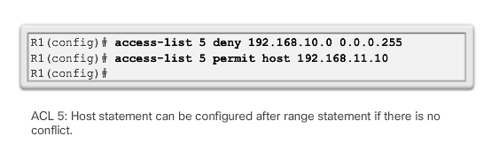
Processing Packet with ACLs
The Order of ACEs in an ACL (cont.)
Notes:
7.3 – Troubleshoot ACLs
7.3.1 – Processing Packets with ACLs
7.3.1.2 - The Order of ACEs in an ACL

Slide 36
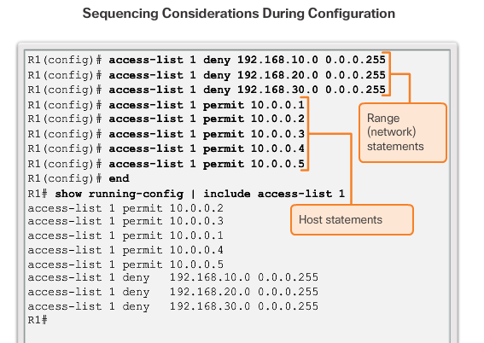
Processing Packet with ACLs
Cisco IOS Reorders Standard ACLs
Notice that the statements are listed in a different order than they were entered.
Notes:
7.3 – Troubleshoot ACLs
7.3.1 – Processing Packets with ACLs
7.3.1.3 - Cisco IOS Reorders Standard ACLs

Slide 37
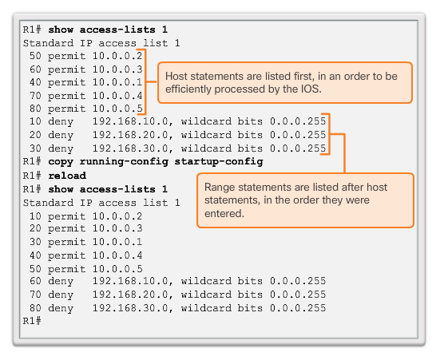
Processing Packet with ACLs
Cisco IOS Reorders Standard ACLs (cont.)
The order in which the standard ACEs are listed is the sequence used by the IOS to process the list.
Notes:
7.3 – Troubleshoot ACLs
7.3.1 – Processing Packets with ACLs
7.3.1.3 - Cisco IOS Reorders Standard ACLs (cont.)

Slide 38
Processing Packet with ACLs
Routing Processes and ACLs
As a frame enters an interface, the router checks to see whether the destination Layer 2 address matches its interface Layer 2 address, or whether the frame is a broadcast frame.
If the frame address is accepted, the frame information is stripped off and the router checks for an ACL on the inbound interface.
If an ACL exists, the packet is tested against the statements in the list.
If the packet matches a statement, the packet is either permitted or denied.
If the packet is accepted, it is then checked against routing table entries to determine the destination interface.
If a routing table entry exists for the destination, the packet is then switched to the outgoing interface, otherwise the packet is dropped.
Next, the router checks whether the outgoing interface has an ACL. If an ACL exists, the packet is tested against the statements in the list. If the packet matches a statement, it is either permitted or denied.
If there is no ACL or the packet is permitted, the packet is encapsulated in the new Layer 2 protocol and forwarded out the interface to the next device.
Notes:
7.3 – Troubleshoot ACLs
7.3.1 – Processing Packets with ACLs
7.3.1 - Routing Processes and ACLs

Slide 39
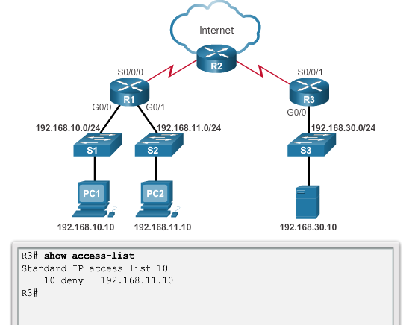
Common Standard IPv4 ACL Errors
Troubleshooting Standard IPv4 ACLs – Example 1
Notes:
7.3 – Troubleshoot ACLs
7.3.2 – Common Standard IPv4 ACL Errors
7.3.2.1 - Troubleshooting Standard IPv4 ACLs – Example 1

Slide 40
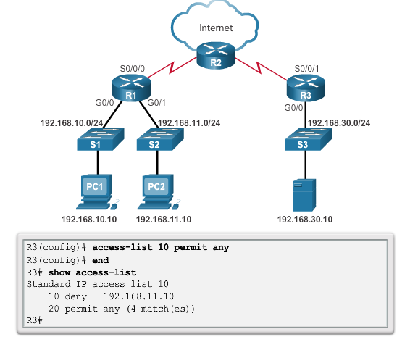
Common Standard IPv4 ACL Errors
Troubleshooting Standard IPv4 ACLs – Example 1 (cont.)
Notes:
7.3 – Troubleshoot ACLs
7.3.2 – Common Standard IPv4 ACL Errors
7.3.2.1 - Troubleshooting Standard IPv4 ACLs – Example 1 (cont.)

Slide 41
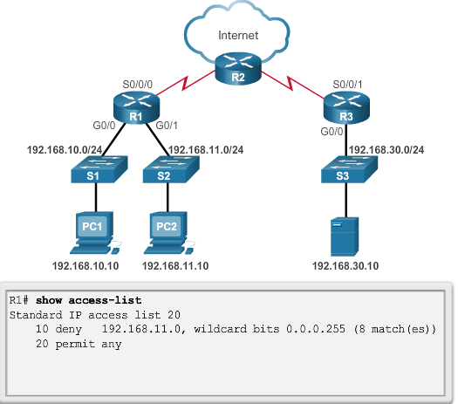
Common Standard IPv4 ACL Errors
Troubleshooting Standard IPv4 ACLs – Example 2
Security Policy: The 192.168.11.0/24 network should not be able to access the 192.168.10.0/24 network.
Notes:
7.3 – Troubleshoot ACLs
7.3.2 – Common Standard IPv4 ACL Errors
7.3.2.2 - Troubleshooting Standard IPv4 ACLs – Example 2

Slide 42
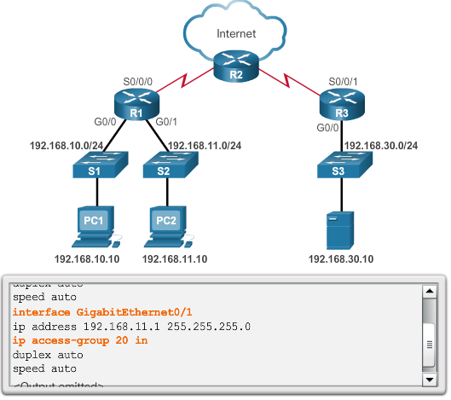
Common Standard IPv4 ACL Errors
Troubleshooting Standard IPv4 ACLs – Example 2 (cont.)
ACL 20 was applied to the wrong interface and in the wrong direction. All traffic from the 192.168.11.0/24 is denied inbound access through the G0/1 interface.
Notes:
7.3 – Troubleshoot ACLs
7.3.2 – Common Standard IPv4 ACL Errors
7.3.2.2 - Troubleshooting Standard IPv4 ACLs – Example 2 (cont.)

Slide 43
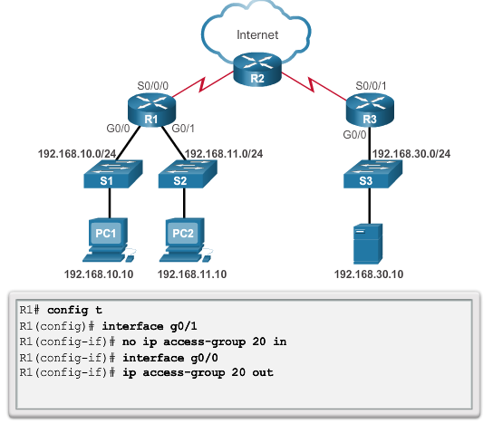
Common Standard IPv4 ACL Errors
Troubleshooting Standard IPv4 ACLs – Example 2 (cont.)
Notes:
7.3 – Troubleshoot ACLs
7.3.2 – Common Standard IPv4 ACL Errors
7.3.2.2 - Troubleshooting Standard IPv4 ACLs – Example 2 (cont.)

Slide 44
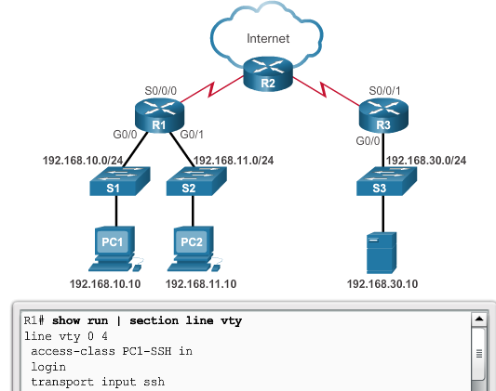
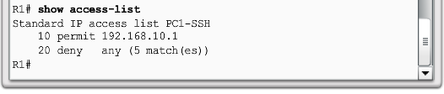
Common Standard IPv4 ACL Errors
Troubleshooting Standard IPv4 ACLs – Example 3
Problem
Security Policy: Only PC1 is allowed SSH remote access to R1.
Notes:
7.3 – Troubleshoot ACLs
7.3.2 – Common Standard IPv4 ACL Errors
7.3.2.3 - Troubleshooting Standard IPv4 ACLs – Example 3

Slide 45
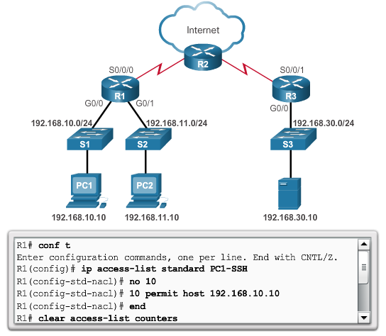
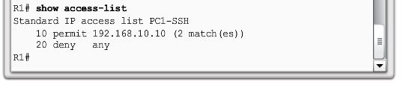
Common Standard IPv4 ACL Errors
Troubleshooting Standard IPv4 ACLs – Example 3 (cont.)
Solution!
Security Policy: Only PC1 is allowed SSH remote access to R1.
Notes:
7.3 – Troubleshoot ACLs
7.3.2 – Common Standard IPv4 ACL Errors
7.3.2.3 - Troubleshooting Standard IPv4 ACLs – Example 3 (cont.)

